Slide 1
COMPUTER ARCHITECTRE TDIT 114
Basic Computer Functions

Slide 2
A Computer
By definition, a computer is an electronic device that processes data, converting it into information that is useful to people.
Computers are controlled by programmed instructions that transform the data into meaningful information.
Generally a Computer is a device that accepts input, processes it, stores data, and produces output.

Slide 3
COMPUTER ARCHITECTURE
The structure and behavior of the various functional modules of the computer and how they interact to provide the processing needs of the user.
Architectural attributes include:
Instruction set of the computer
Number of bits used to represent various data types
I/O mechanisms
Addressing Techniques etc.

Slide 4
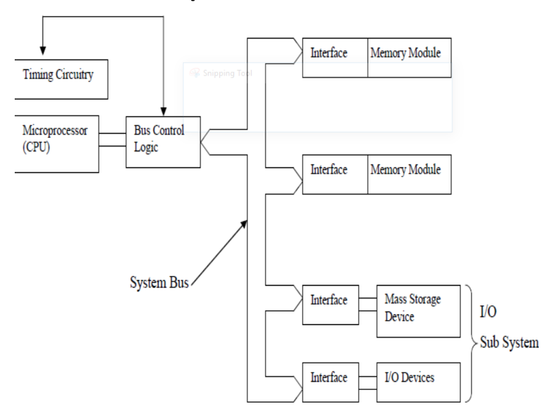
Computer structure

Slide 5
Why study computer architecture
To understand the computer’s functional components, their characteristics, their performance and their interactions.
Computer architecture helps to structure programs that can run more efficiently on a real machine (CPU speed, memory etc.)
To know the most cost effective computer for use in an organization.
Computer architecture concepts are needed in other courses e.g. (programming, and operating Systems)

Slide 6
Information in a computer -Instructions
Instructions specify commands to:
Transfer information within a computer (e.g., from memory to ALU)
Transfer of information between the computer and I/O devices (e.g., from keyboard to computer, or computer to printer)
Perform arithmetic and logic operations (e.g., Add two numbers, Perform a logical AND).
A sequence of instructions to perform a task is called a program, which is stored in the memory.
Processor fetches instructions that make up a program from the memory and performs the operations stated in those instructions.

Slide 7
Data
Data are the “operands” upon which instructions operate.
Data could be:
– Numbers,
– Encoded characters.

Slide 8
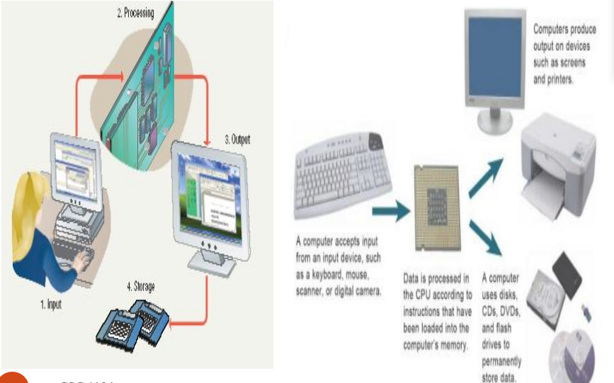
Basic Computer Functions
Input, processing, storage, output

Slide 9
Input
Input: Is whatever is typed, submitted or transmitted to a computer by a person, the environment, or another computer.
Examples of Input:
Words and symbols.
Numbers
Pictures
Audio signals from a microphone
Signals from another computer
Temperature, speed, pressures, etc. from sensors

Slide 10
Input devices
Input: The data or information entered into a computer or the process of entering data or information into the computer for processing, storage and retrieval, or transmission.
Input devices allow input into the computer
Examples of input devices
Keyboards
Mouse
Touch screen
Digital camera
Scanner
Point of sale terminals
Bar code reader
Microphones
prerecorded sources like CD & DVS

Slide 11
Processing
Processing - manipulation of data.
Data are symbols that represent raw facts, objects, and ideas about people, places, events, and things that are of importance in an organization.
A computer program or software is a series of instructions that tell a computer how to carry out a processing task.
Examples of Processing
Arithmetic calculations
Sorting a list
Modifying pictures
Drawing graphs

Slide 12
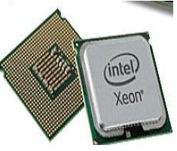
Processing devices CPU
Processor/Central Processing Unit (CPU): A set of electronic circuits that perform the computer’s processing actions. In microcomputers, the processor is a microprocessor – a central processor contained on a single computer chip.

Slide 13
CPU cont’d
A chip is a collection of electronic components in a very small, self-contained package. Chips perform the computer’s processing actions, including arithmetic calculations and the generation of lines, images, and sound.
Examples of chips include sound chips which generate signals to be output as tones.

Slide 14
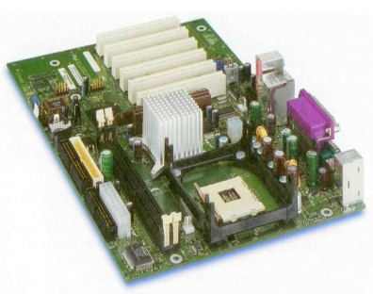
The Motherboard
The processor/CPU can take several forms. Microcomputers contain a specific micro-processor chip as their CPU. This is put into a protective package, and then mounted onto a board contained within the computer. This board is called a system board or a mother board.

Slide 15
Cont’d
The system board contains other chips and circuitry that carry out processing.

Slide 16
Memory devices
Memory is made up of one or more sets of chips that Store data or program instructions either temporarily or permanently. No processing takes place in memory. Instead, memory stores data, information and instructions. Memory is divided into two types:
Random Access Memory (RAM)
RAM holds data and program instructions temporarily while the CPU works with them.
RAM is volatile, meaning it holds data only when the power is on. When the power is off, RAM's contents are lost.
More RAM results in a faster system.

Slide 17
Cont’d
b) Read Only Memory (ROM) - Permanent storage of programs.
ROM is called non-volatile memory because it never loses its contents.
Holds instructions that the computer needs to operate.
This type of memory lets you store the data needed to start up or boot the computer
Essential start-up data contained in ROM is a computer BIOS
The BIOS includes instructions on how to load basic computer hardware and includes a test referred to as a POST (Power On Self Test) that helps verify the computer meets requirements to boot up properly.

Slide 18
Memory cont’d
Memory is measured interms of:
Kilobyte (KB) - 1,000 bytes
Megabyte (MB) - 1,000,000 bytes
Gigabyte (GB) - 1,000,000,000 bytes
Terabyte (TB) - 1,000,000,000,000 bytes

Slide 19
Outputting
Output - the result produced by a computer after processing the data.
Output device –displays, prints, or transmits the results after processing.
Examples of Output
images on a monitor
Printed documents
Sounds

Slide 20
Output Devices
Output: The results of inputting and processing data and information returned by the computer, either directly to the person using the system or to secondary storage.
Common forms of output are:
reports,
schedules,
budgets,
newsletters among others.

Slide 21
Output devices cont’d
Examples of output devices include:
Printers
Speakers
Monitor
Projectors
Note:
Communications devices (such as modems and network interface cards) perform both input and output, allowing computers to share information.

Slide 22
Storage
Memory and Storage
Memory - the area of a computer that temporarily holds data that is being processed or waiting to be processed, stored, or output.
Storage - The area where data can be left on a permanent basis while it is not needed for processing.
Examples of Storage
CD-ROM (Compact Disk Read-Only Memory)
Flash disks
Hard disks

Slide 23
Cont’d
Storage Devices The purpose of storage is to hold data permanently, even when the computer is turned off.
Storage devices hold data not currently being used by the CPU.
Data is commonly stored on a magnetic or optical disk.
A disk drive is a device that reads data from and writes data to a disk. Most new computers feature a floppy disk drive, a hard disk drive, and an optical disk drive.
The most common optical storage devices are CDROM and DVD-ROM drives.

Slide 24
Differences between memory and storage
Three major distinctions between storage and memory.
There is more room in storage than in memory.
Contents are retained in storage when the computer is turned off, whereas programs or the data in memory disappear when you shut down the computer.
Storage devices operate much slower than memory chips, but storage is much cheaper than memory.

Slide 25
Computer components
Central Processing Unit(CPU)
Computer memory (RAM and ROM)
Input/output subsystem
System interconnection

Slide 26
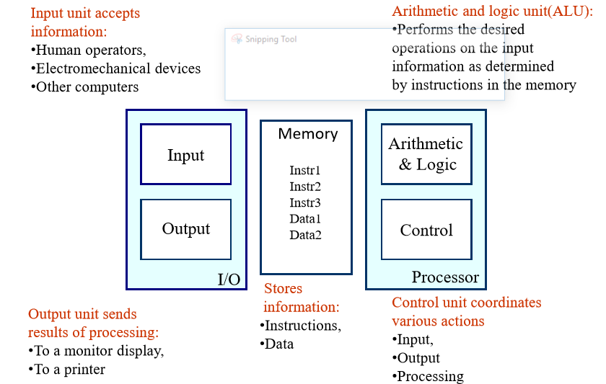
Functional Units of a Computer

Slide 27
Central Processing Unit
Indicative content
Components of CPU
Data Processing in CPU
Determining processor Speed

Slide 28
The Central Processing Unit
The central processing unit (CPU): The heart and brain of the computer. It receives data input, processes information and executes instructions.
 It is the center of all processing activities. It is here that all processing is controlled, all data are manipulated, arithmetic computations are performed and logical comparisons are made.

Slide 29
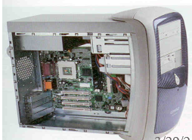
Cont’d
System Unit: The hardware unit that houses a computer’s processor, memory chips, ports, and add-inboards.

Slide 30
CPU Components
In large computers such as super computers and mainframe computers, processing tasks may be handled by multiple processing chips.
In the average microcomputer, the entire CPU is a single unit, called a microprocessor.

Slide 31
Cont’d
Regardless of its construction, every CPU has at least two basic parts:
1. The Control Unit
2. The arithmetic logic unit
3. Working registers

Slide 32
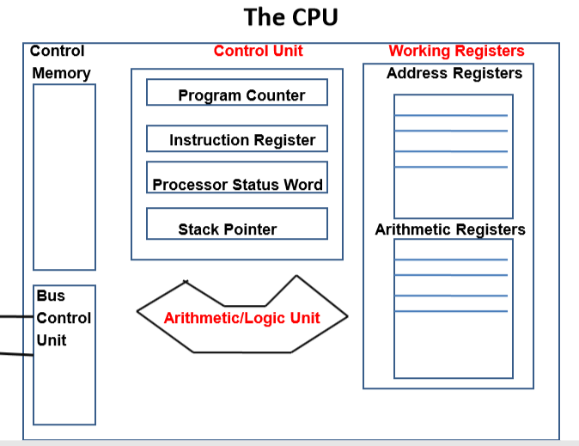
Structure of the CPU

Slide 33
Control Unit
The Control Unit regulates the computer operations much as a “traffic cop” would. Its main functions are:  select and interpret instructions and to send appropriate signals to other units in the computer for their execution.
Direct the flow of data through the CPU, and to and from other devices.
Control, supervise, and oversees all the activities of a computer and monitors the execution of any program processed.
The control unit can execute only one instruction at a time, but it can execute instructions so quickly (millions per second) that it can appear to do many different things simultaneously.

Slide 34
Computer operations
Operation of a computer can be summarized as: –
Accepts information from the input units (Input unit).
Processes the information (ALU).
Stores the information (Memory).
Provides processed results through the output units (Output unit).

Slide 35
Components of the control unit
The Program Counter (PC) Holds the address of the main memory location from which the next instruction is to be fetched.
Instruction Register (IR) Receives the instruction when it is brought from memory and holds it while it gets decoded and executed

Slide 36
Components of the control unit
Processor Status Word (PSW) contains condition flags which indicate the current status of the CPU and the important characteristics of the result of the previous instruction
Stack Pointer (SP). It hold the address at the top of the memory stack.

Slide 37
The Arithmetic/Logic Unit (ALU)
The arithmetic/logic unit (ALU) performs the four basic arithmetic operations of:
Addition,
Subtraction,
Multiplication and
Division as well as
The logical operations of the comparison between two pieces of data i.e. Greater Than (>), Less Than (<), EqualTo (=)
Results of the operations are stored back in the memory or retained in the processor for immediate use.

Slide 38
ALU cont’d
All computer applications - from weather predictions to word processing are achieved through these five simple operations.
The ALU operations are performed sequentially (one after another),based on instructions from the control unit.

Slide 39
Primary storage
Primary storage or main memory (RAM) stores data and program statements for the CPU.
It has four basic purposes, namely;
To store data that have been input until they are transferred to the arithmetic/logic unit for processing.
To store data and results during intermediate stages of processing.
To hold data after processing until they are transferred to an out put device.
To hold program statements or instructions received from input devices and from secondary storage.

Slide 40
Primary Storage cont’d
The larger the memory area, the larger the programs that can be stored and executed.
In the earlier days, it was common to find personal computers with 4MB of RAM but as multi media (graphics, animation and video), becomes common in the market place, personal computers require high capacity of RAM i.e. 128MB, 256MB, 512MB, 1GB, 3GB, ITB etc.

Slide 41
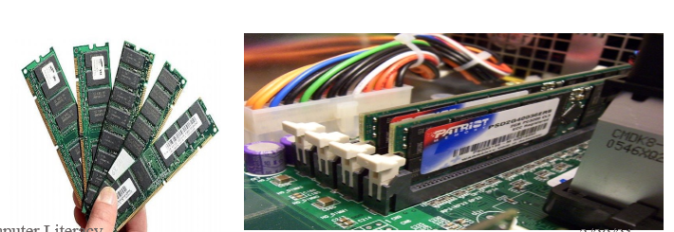
Primary Storage cont’d

Slide 42
Primary storage
All memory locations and I/O registers are composed of bits.
A byte: a group of 8 bits
A nibble: a group of 4 bits
A word: a group of 2,3, or 4 bytes depending on the computer and its system bus structure.
Each byte has an identifying address associated with it.
When a byte is to be accessed its address is transmitted to the appropriate interface via the address lines.
Addresses are composed of bit combinations and the set of all bit combinations for a given situation is called an address space.

Slide 43
Primary storage
The number of bits in an address determines the size of an address space. If an address is n bits wide then there are 2^{n} possible addresses (0 – 2^{n}–1).
The number of address lines in the system bus dictates the size of memory, or memory and the I/O space. A total of n address lines would imply a maximum memory (or overall memory and I/O) capacity of 2^{n} bytes.

Slide 44
Primary storage
16 address lines imply 216 = 26 (210) = 64K
Putting information into or taking information from a memory location is called memory access.

Slide 45
The processing sequence -Machine cycle
The CPU follows a set of steps-called a machine cycle for each instruction it carries out.
By using a technique called pipelining, many CPUs can process more than one instruction at a time.
The machine cycle includes two smaller cycles:
The instruction cycle
The execution cycle

Slide 46
Instruction cycle
Fetching: Before the CPU can execute an instruction, the control unit must retrieve (or “fetch”) a command or data from the computers memory.
Processor reads instructions and reads/writes data from/to the memory during the execution of a program.
Decoding: Before a command can be executed, the control unit must break down/interpret/translate the instruction into a form that the CPU can understand.
All required data = fetched from main memory & put in data registers

Slide 47
Execution cycle
Execution cycle. The data is manipulated (worked on) by the computer.
The results of the manipulations are stored memory.
After the execution cycle, the process begins the next instruction. This process continues until the last instruction of the program has been executed.

Slide 48
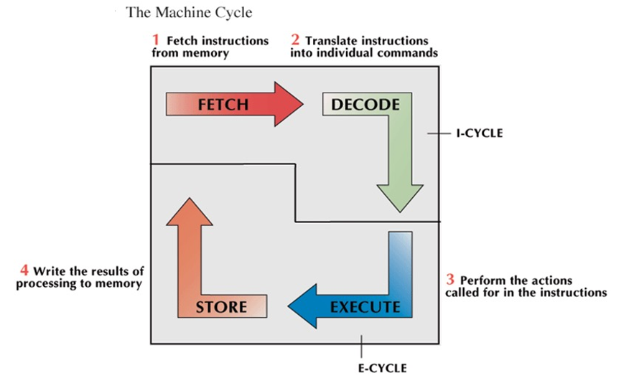
The Machine Cycle cont’d

Slide 49
Note
In theory, instructions and data could be fetched one bit at a time.
In practice, a group of bits is fetched at a time.
Group of bits stored or retrieved at a time is termed as “word”
Number of bits in a word is termed as the “word length” of a computer
“Address” is associated with each word location.

Slide 50
Classifications of memory
Memory can be classified as to whether it can retain its contents when power is turned off.
Volatile: Metal Oxide Semiconductor
Erased when computer is switched off. E.g RAM
Non Volatile: Magnetic Core
Can retain its content while power is switched off. E.g. ROM

Slide 51
Processor Speed
Determining processor speed
There are five (5) elements that determine processor speed
System clock
Bus width
Cache memory
Registers
Available memory (Internal memory)

Slide 52
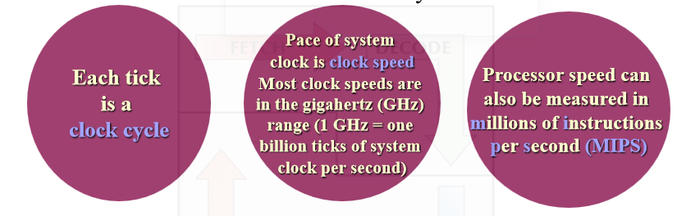
System clock
System clock is a component that provides the timing for all processor operations.
It is located within the control unit.

Slide 53
System clock cont’d
If a computer has a clock speed of 300 MHz, then its system clock "ticks" 300 million times every second.
Clock speed has a tremendous impact on CPU performance. A CPU operating at 300MHz can process data nearly twice as fast as the same one operating at 166MHz.

Slide 54
Bus width
A bus is a path between the components of a computer.
There are two main buses in a computer: the internal (or system bus) and the external or (expansion) bus.
The system bus resides on the motherboard and connects the CPU to other devices that reside on the motherboard.
An expansion bus connects external devices, such as keyboard, mouse, modem, printer, etc. to the CPU.
The system bus has two parts:
The data bus and
The address bus.

Slide 55
Bus cont’d…
The Data bus is an electrical path composed of parallel wires that connects the CPU, memory, and the other hardware devices on the motherboard.
The address bus is a set of wires similar to the data bus. The address bus connects CPU to memory and carries only memory address

Slide 56
Bus cont’d…
Requests for data are sent from the CPU to RAM along the address bus. The requests consist of a memory address.
The data comes back to the CPU via the data bus.
The number of wires in the bus affects the speed at which data can travel between hardware components.
Because each wire can transfer 1 bit of data at a time, an 8-wire bus can move 8 bits at a time which is a full byte.

Slide 57
Registers
Registers are high speed memory locations built directly into the ALU and used to hold instructions and data currently being processed.
The size of the registers (also called word size) determines the amount of data with which the computer can work at any given time.

Slide 58
Registers cont’d
The bigger the word size, the more quickly the computer can process a set of data.
Today, most PCs have 32-bit registers, meaning the CPU can process four bytes of data at one time. Register sizes are rapidly growing to 64 bits.

Slide 59
Working registers
They are Arithmetic registers (accumulators) and address registers.
Arithmetic Registers: Temporarily hold the operands and the result of the arithmetic operations
Address Registers: for addressing data and instructions in main memory.
Accessing a register is faster than accessing memory.
If a register can be used for both arithmetic operations and addressing it is then called a general purpose register.

Slide 60
Cache memory
Moving data between RAM and the CPU’s registers is one of the most time consuming operations a CPU must perform.
A partial solution to this problem is to include a cache memory in the CPU.
Cache memory is similar to RAM, except that it is extremely fast compared to normal memory and it is used in a different way.

Slide 61
Cache memory
When a program is running and the CPU needs to read data from RAM, the CPU checks first to see whether the data is in cache memory.
If the data is not there, the CPU reads it from RAM into its registers but also keeps a coy of the data in cache memory.
The next time the CPU needs the same data, it finds it in the cache memory and saves the time needed to load that data from RAM.

Slide 62
Cache memory
Therefore, cache memory speeds up processing by storing frequently used data or instructions in its high speed memory.
Today, many CPUs have as much as 256KB cache memory built in.
Cache memory is sometimes described in levels of closeness and accessibility to the microprocessor.
Cache built into the CPU itself is referred to as Level 1 (L1)cache. Cache that resides on a the motherboard is also called Level 2 (L2) cache.

Slide 63
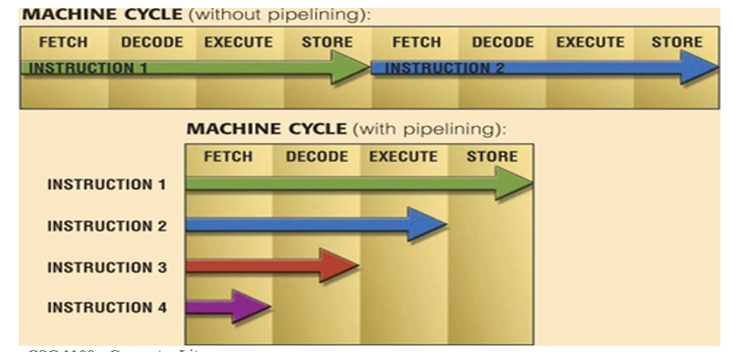
Pipelining
Pipelining: CPU begins fetching second instruction before completing machine cycle for first instruction.
Results in faster processing

Slide 64
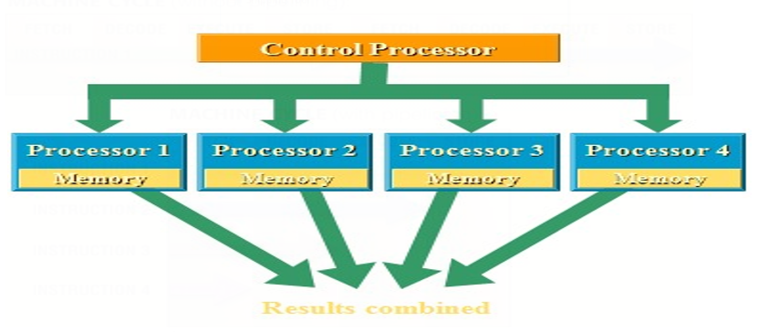
Parallel processing
Parallel Processing: Using multiple processors simultaneously to execute a program faster.
Requires special software to divide problem and bring results together.

Slide 65
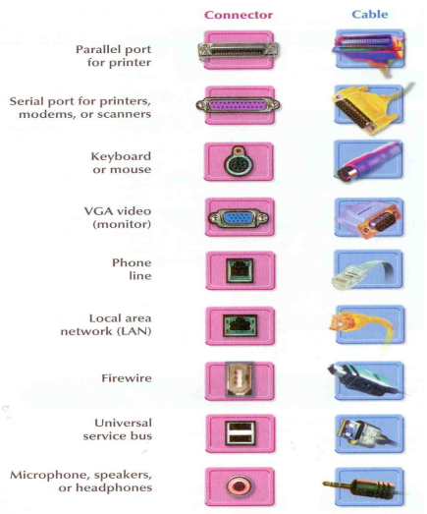
Ports
Port: A connector through which input/output devices can be plugged into the computer.

Slide 66
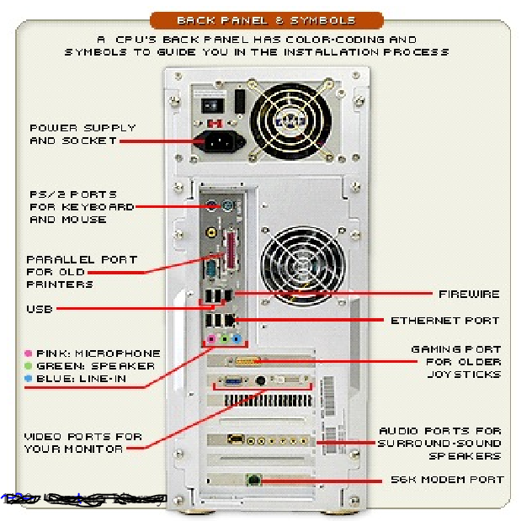
Ports cont’d

Slide 67
Universal Serial Bus
Universal Serial Bus (USB):A general purpose port that can connect up to 128 devices, and also hot swappable, meaning that devices can be plugged in or unplugged without having to shut down or reboot the system.
Plug and Play: The ability to install devices into a computer when the computer itself makes any necessary internal adjustments.

Slide 68
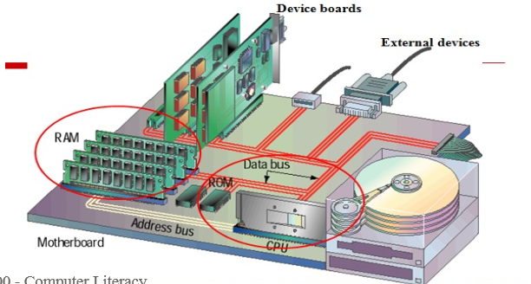
Note
Processing takes place in the PC's central processing unit (CPU). The system's memory plays a crucial role in processing data. Both the CPU and memory are attached to the system's motherboard, which connects all the computer's devices together, enabling them to intercommunicate.
The CPU, memory and computer’s devices intercommunicate

Slide 69
System Interconnection
Mechanism to provide communication between the CPU, memory and the I/O sub system. It consists of the System Bus and the Interfaces

Slide 70
System bus
A set of conductors that connect the CPU to its memory and I/O devices. The bus conductors are normally separated into 3 groups:
The Data Lines: for transmitting information
Address Lines: Indicate where information is to come from or where it is to be placed.
Control Lines: To regulate the activities on the bus.

Slide 71
Interfaces
Circuitry needed to connect the bus to a device.
Memory interfaces
Decode the address of the memory location being accessed.
Buffer data onto/off the bus.
Contain circuitry to perform memory reads or write.
I/O interfaces
Buffer data onto/off the system bus
Receive commands from the CPU
Transmit information from their devices to the CPU.

Slide 72
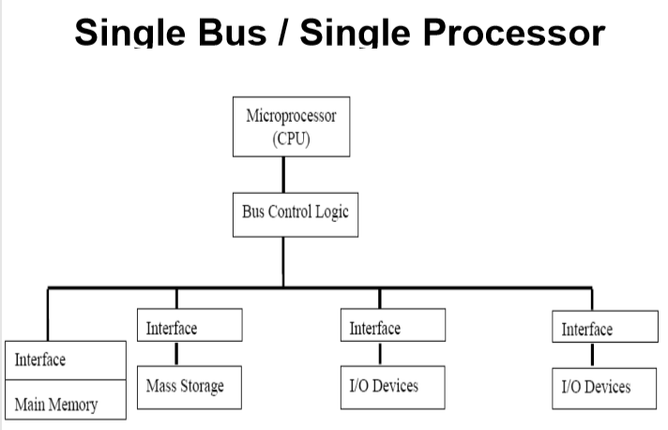
Arrangements of a computer structure
The single bus / Single processor architecture: one processing element and all the other components are connected to a single link (the System Bus)

Slide 73
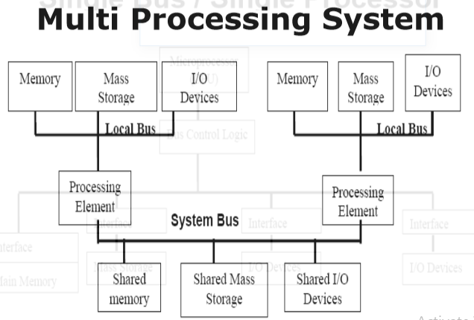
Cont’d
The Multiprocessing System: has several processing elements surrounded by different subsystems and a central link (the system bus) connecting the different subsystems together.

Slide 74
Multi-Processing System
The links in the subsystems are called local buses.
Each subsystem operates as an independent computer but can take advantage of the shared resources.
The shared main memory can be used for passing information between subsystems
The shared mass storage can be used to store large programs and large quantities of data that are needed by more than one subsystem.
The competition for the shared resources by the different elements is called contention.

